Slide 1
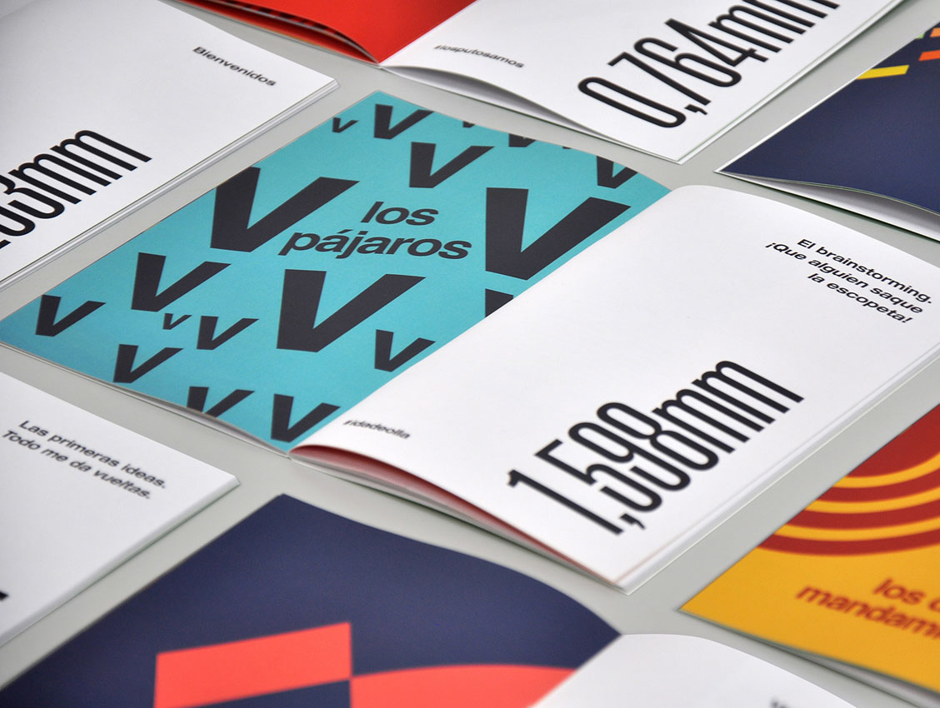
Advanced higher Graphic communication
Graphic Types and Techniques 2 - Promotion

Slide 2
Learning intentions & success criteria
Learning Intentions
Overview of promotional graphic types and techniques.
Success Criteria
Describe and explain the different promotional graphic types and techniques used in industry.

Slide 3
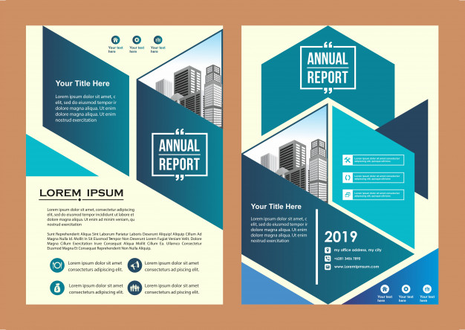
Creative layout techniques
Applying a creative layout technique to graphic design work can:
Enhance the user experience by creating predictable patterns for users to follow
Lead to a more enjoyable audience experience
Be used to appeal to a specific target audience
Influence fashion trends in graphic design
Be used to reflect or convey the brand identity of a company
Convey an important message through use of elements and principles
Can make a company stand out, motivate potential customers, cultivate brand recognition and influence public perception of a company/service/product

Slide 4
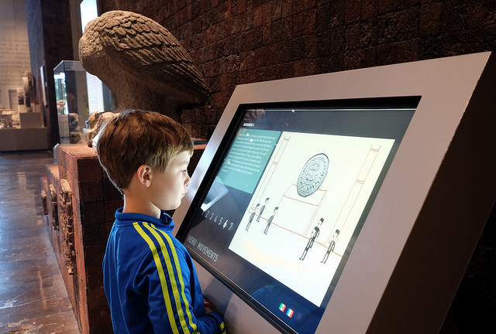
Interactive screens
This refers to more than touchscreen smartphones or tablets, they can also be interactive kiosks used in retail or marketing.
General benefits include:
They can make technology more intuitive to use
Multiple languages can be added to the software, reaching out to a wider audience
Can hold the attention of an audience due to dynamic effects (user experience relating to company/brand)

Slide 5
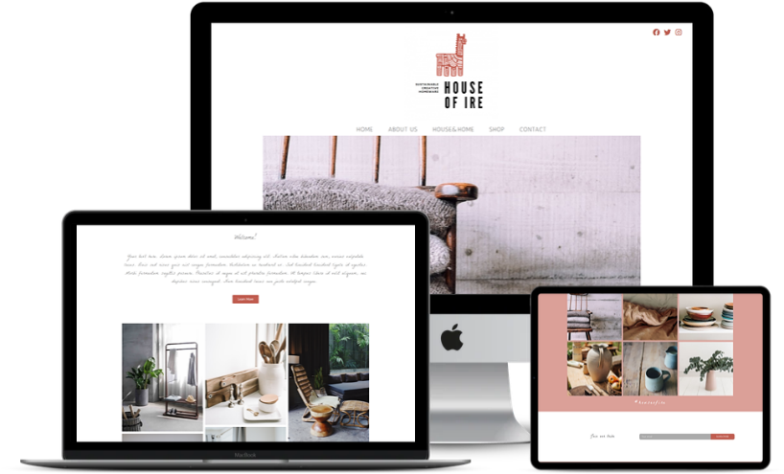
websites
General benefits of a website to an audience include:
Accessible worldwide and in multiple languages
Can be access on multiple devices (smartphones, tablet, smart TV, computer etc.)
Can be accessed 24/7
Audiences can look at more than one page at the one time by opening numerous windows/tabs
Interactive media content can be displayed on a website. Can also include dynamic effects, videos/multimedia and links to social media

Slide 6
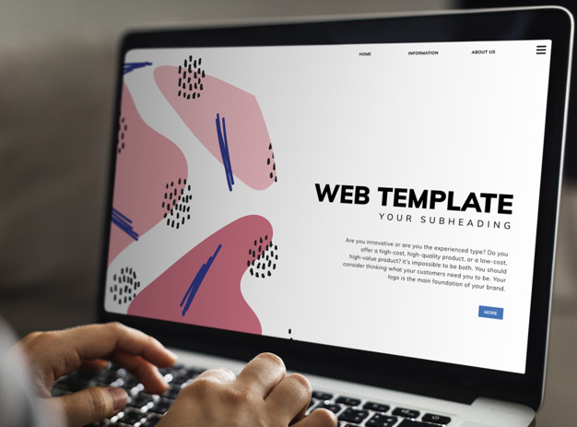
Websites advantages
Advantages to a company include:
Websites can be easily updated
Can link to other websites
They are less expensive to promote/advertise a company compared to printed media, television advertising
They are more environmentally friendly when it comes to advertising and marketing compared to printed media
Increases the credibility of a company/brand

